Slide 1



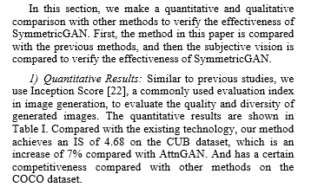
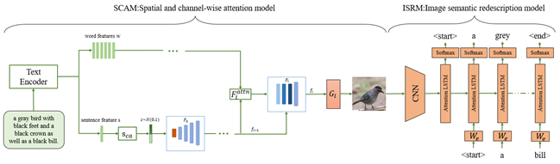
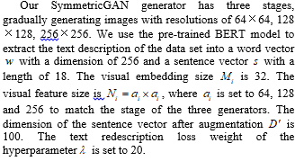
2021 IEEE Conference on Telecommunications, Optics and Computer Science (TOCS 2021)
10-11 December, 2021 Shenyang, China
Guangxi Chen, Qiaochu Li, Min Tang
School of Art & Design Guilin University of Electronic Technology, Guilin, China
Email: chax@guet.edu.cn, 19032304012@mails.guet.edu.cn, dengtangmin@126.com
1. Abstract
4. Implementation details
Generating images from a given natural language description is a challenging task, and its primary purpose is to generate images which are visually real and semantically consistent. In this article, we propose a text-to-image-to-text model (SymmetricGAN) based on the spatial-channel attention mechanism, which has two modules: the spatial-channel attention module (SCAM) and the image semantic redescription module (ISRM). The spatial-channel attention module separates different visual attributes, so that the model pays more attention to the sub-regions corresponding to the most relevant words, and generate target images from coarse to fine under the cascade architecture. The image semantic redescription module regenerates the description text of the image to ensure that the composite image is consistent with the original semantic description. We show the comparison and results on two general datasets.
2. SCAM: Spatial-Channel Attention Module
5. Conclusion
Fig.1. Model of SymmetricGAN for text to image generation.
In this paper, we propose a text-to-image-to-text framework (SymmetricGAN) based on spatial-channel attention and semantic consistency, which generates realistic images according to a given natural language description. SCAM generates word- and sentence-level embedding, and generates images from coarse to fine in a cascaded framework, and gradually enhances the diversity and semantic consistency of images by using the attention of space and channels. ISRM regenerates the description sentence from the synthesized image to ensure that the image is consistent with the description of the original text. We show the comparison and results on two general datasets.
3. Objective functions

