Slide 1
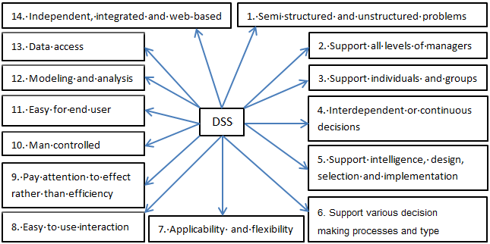
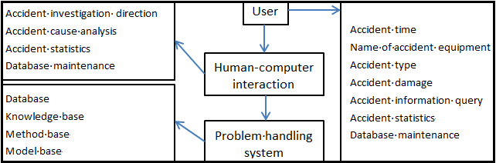
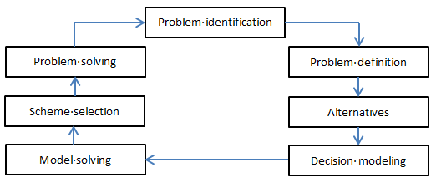
Framework of Special Equipment Accident Investigation Decision Support System Based on IDSS Technology
Jun Qiu, Liangsheng Chen, Leijing Yang
Shanghai Institute of Special Equipment Inspection and Technical Research ,Henan Special Equipment Safety Testing Institute
E-mail: qiuj@ssei.cn, chls@ssei.cn, 362823505@qq.com
1. Abstract
In order to solve the problems of the lack of experience and ability in the investigation and treatment of special equipment accidents in China, and fully excavate, summarize and utilize the existing valuable accident resources and excellent expert experience, guided by problems and demands, and based on the existing resources and research accumulation, this paper proposes to build a comprehensive intelligent decision support system IDSS, which consists of database, model base, method base, knowledge base and text base, has intelligent, interactive and integrated features, and faces decision-makers and decision-making process. By using the open and distributed characteristics of the system, it can give full play to the joint advantages of users, computers, communication networks and other resources, and provide decision support for special equipment accident investigation and technical analysis. The system can also continuously gather industry resources and experience, form derivative application functions such as safety education and training, accident emergency drill, etc., and make beneficial contributions to prevent and reduce special equipment accidents, and further improve the safety level of special equipment.
Key features and functions of intelligent decision support system for special equipment accident investigation
4. System Structure Design
As shown in Figure 3, the frame structure design of intelligent decision support system for special equipment accident investigation includes three parts: user interface, man-machine interface and problem processing interface. Each part (sub module) has different structures and realizes different functions.
2. Decision Support System (DSS)
DSS is an intelligent human-computer system based on management science, operations research, cybernetics and behavioral science, using computer technology, simulation technology and information technology to support decision-making activities for structured, unstructured and semi-structured decision-making problems.
Fig. 3.Schematic diagram of system (sub module) structure design
5. Conclusion
Under the background of "double decline" trend of national special equipment accidents, in order to solve the problem of lack of experience and ability in accident investigation and handling, it is an effective and feasible scheme to improve decision-making credibility and decision-making efficiency and avoid experience misunderstanding by using existing resources and giving full play to expert experience.
The frame structure of decision support system including database, model base, method base, knowledge base and text base is designed and preliminarily constructed, and the functions and characteristics of each module and sub module are clarified. The key and difficulty lies in the construction of database and model base is analyzed, and the feasible implementation path is given;
Decision making process based on DSS
3. Key Features and Functions of the System
In the process of the development of decision-making theory and method, great changes have taken place in intelligent decision-making theory and method from single decision-making to group decision-making, from single objective decision-making to multi-objective decision-making, and from static decision-making to dynamic decision-making.

