Slide 1
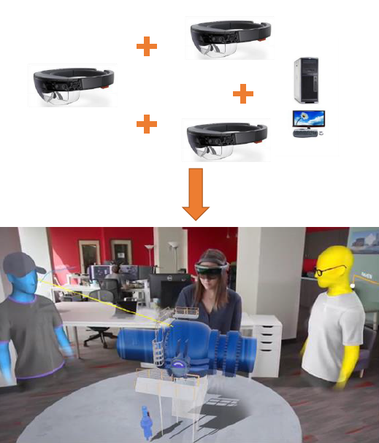
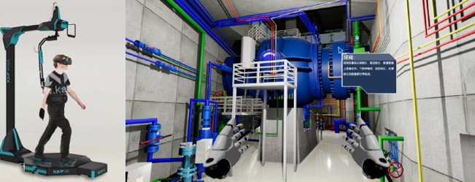
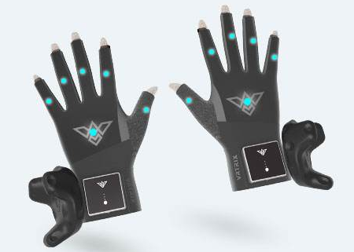
Research and application of virtual reality technology in hydropower station production
Wenhui Liu
Powerchina Huadong Engineering Corporation Limited
liu_wh2@hdec.com
Abstract
Generalized virtual reality technology includes virtual reality (VR), augmented reality (AR) and mixed reality (MR), which are immersive, interactive and imaginative. This paper combines the characteristics of virtual reality technology and hydropower station production to enumerate the application scenarios of virtual reality technology,such as immersive training, virtual operation, virtual overhaul and and maintenance, remote fault diagnosis and emergency plan rehearsal in hydropower station production .Virtual reality technology can provide more operation opportunities for hydropower station operators, shorten the training time of operators and improve the technical level of operators.
Immersive remote fault diagnosis
Fig. 5.AR remote fault diagnosis
As shown in Fig.5, Remote experts, supplier technicians and operators wear AR equipment at the same time. Through 5G or Wifi and other networks, operator send call requests to remote experts and supplier technicians through AR equipment, and share pictures for discussion and consultation, which is convenient and fast.
Immersive training
The traditional training method of hydropower station is mainly the combination of documents, pictures and videos, which has some obvious disadvantages, such as poor interactivity and poor sense of substitution, besides, it also can not provide the immersive experience. The immersive and interactive characteristics of virtual reality technology can effectively improve this situation and will effectively improve the training effect.
Fig. 2.VR roaming
Virtual environment building method
The main technologies for roaming in virtual environment are Geometry-Based Modeling and Rendering, Image-Based Modeling and Rendering and hybrid modeling. Geometry-Based Modeling and Rendering (GBMR) is commonly used in the modeling of large-scale scenes. Its main workflow as shown in the Fig.1.
Fig. 1.Virtual roaming technology workflow based on GBMR
C.Virtual operation
The hydropower station has a high level of automatization and Safety. The operators of the hydropower station have some opportunities to manually operate the equipment every year, However, it is not enough for operators to master equipment operation skills. So the virtual reality technology is used to provide more opportunities for manual operation practice in the virtual scene.This can greatly improve the ability of the hydropower station staff, and ensure that the hydropower station staff can operate the equipment manually even if the automatic control fails due to emergencies.
Fig. 3.VR gloves
Conclusion
This paper mainly introduces five application scenarios of virtual reality technology in the production process of hydropower station, such as immersive simulation training, virtual operation, virtual overhaul and maintenance, emergency plan drill and remote fault diagnosis, as well as the role of the corresponding scenarios in the production of hydropower station, but the application is not very in-depth.However, With the development of virtual reality technology, how to use virtual reality technology combined with on-site demand for intelligent construction of hydropower station has become a hot issue and a trend of hydropower industry.

