Slide 1
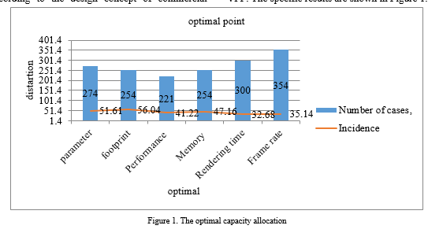
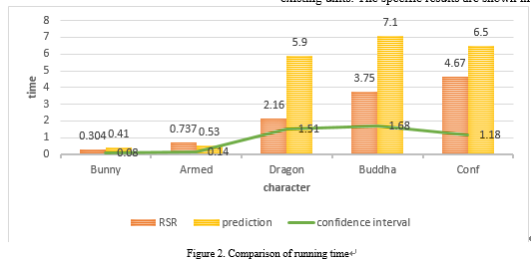
Remote Real-Time Interaction Technology of Wind Power Based on AR
Yong Du, Baoyu Xie, Mingxiang Ba, Zunyan Zhang
Guodian Power Hunan Langshan Wind Power Development Co., Ltd, Changsha, China
503540017@qq.com, 12021403@chnenergy.com.cn, 12081796@chnenergy.com.cn, 12093967@chnenergy.com.cn
Abstract—with the continuous development of China's energy modernization reserve, the development of various new energy sources is becoming more and more important. As the most important part of China's clean energy, how to carry out real-time interactive control of wind power energy is the key of wind power energy management, and the use of AR technology plays a key role in remote control. Augmented reality technology is a new technology developing continuously in virtual reality technology. By combining the real-time interaction of wind power control and the situation that may occur at any time in the control process, the virtual interaction system is established to perfectly simulate and reproduce the virtual reality scene and real control situation, so as to give users a sense of experience beyond reality. The experimental results show that the research on remote real-time interaction technology of wind power based on AR improves the efficiency of wind power management by 8.36%. On mobile devices, with the help of virtual reality technology and camera, AR technology can be realized and meet the needs of applications in some fields. By studying the technical means of camera real-time attitude estimation and three-dimensional registration in unknown environment, in order to achieve the integration of virtual wind power scene and real scene, so as to focus the wind farm scene in the hands of the controller. According to the limitations of the research on wind power remote real-time interaction, the automatic extraction is updated and iterated in an innovative way, and the layout and location information of various interaction scenes are analyzed, discussed and summarized, so as to provide the research results of wind power remote real-time interaction technology of AR in China.
Conclusion
Although in the research of wind power remote real-time interaction technology based on AR, there are great deficiencies in the content of the article due to the one-sided data that may be collected. With the development of society and the progress of cities, the concept of digital city has penetrated into the public. With the continuous development of information and communication technology in distribution network, the interaction between demand side and networking is gradually strengthened. Because the wind speed is random, the wind speed sequence can be regarded as a random time series. Therefore, the idea of least squares recursion can be applied to the field of wind power prediction. The least square method has good statistical properties. The forgetting factor can modify the results of the least square method by changing the weight according to the error. At the same time, it can determine the data window of the input data. Experiments show that this method can get better results. The dispatching mode of power grid needs to be adjusted accordingly in the environment of power market. There are still many steps to study the remote real-time interaction technology of wind power based on AR, which cannot be involved due to space and personal ability. In addition, the practical application effect of the relevant experiments of AR virtual reality technology can only be compared with the traditional model from the level of theory and simulation.

