Slide 1





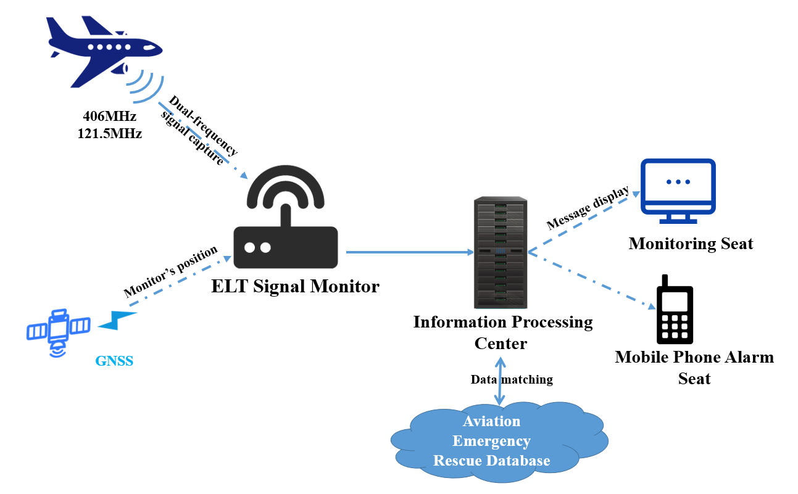
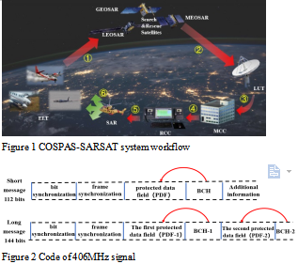
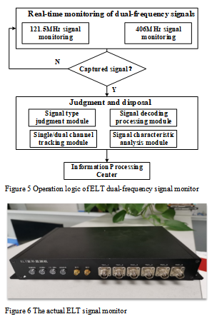
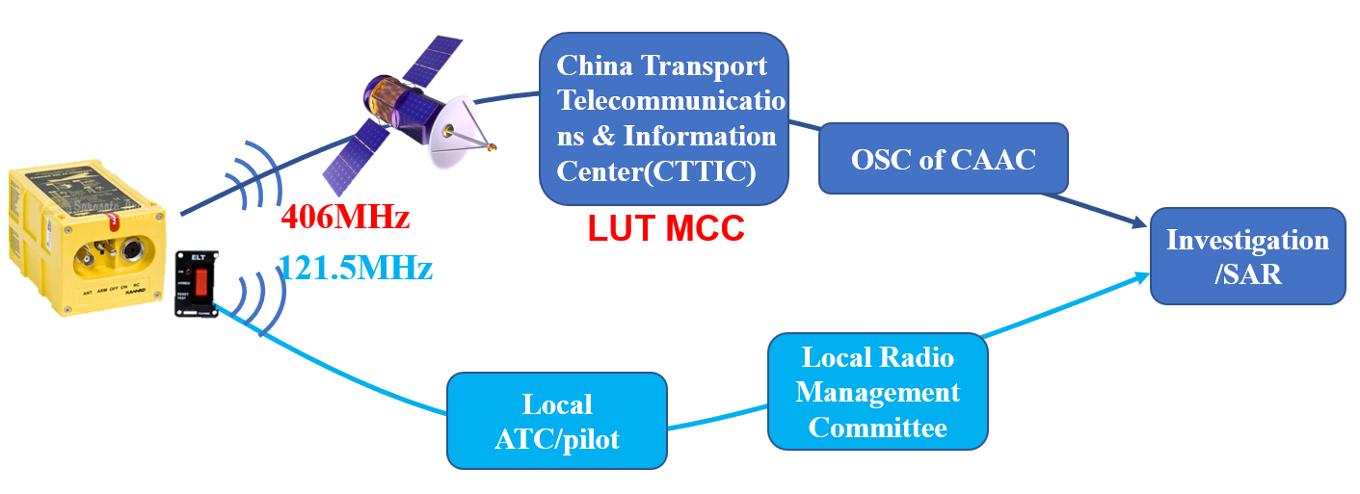
An ELT Signal Monitoring and Alarm System
Abstract
The Emergency Locator Transmitter (ELT) is capable of transmitting distress signals when an aircraft is in distress, providing important clues for search and rescue (SAR). According to the regulations of Civil Aviation Administration of China (CAAC), the ELT of aircrafts operating in China must transmit emergency signal by both 121.5MHz and 406MHz. At present, the civil aviation air traffic control (ATC) in China cannot accurately and efficiently obtain alarms from aircraft in distress because of the different way of receiving the two signals. In order to solve the current problem, an ELT signal monitoring and alarm system is proposed. It can provide an ability of monitoring 121.5MHz and 406MHz ELT signals at the same time, and obtain more information of aircraft in distress by matching the ELT signal and ELT database. This is a more effective way to monitor aircraft in distress than the Global Satellite Search and Rescue System (COSPAS-SARSAT) does. Currently, it is being tested and verified in Chengdu Shuangliu International Airport.
System Architecture
The ELT signal monitoring and alarm system includes five parts: ELT signal monitor, information processing center, monitoring seat, mobile phone alarm seat and aviation emergency rescue database. The system architecture is shown in Figure 4.
COSPAS-SARSAT system
COSPAS-SARSAT system is a global satellite SAR system jointly developed by Canada, France, the United States and the former Soviet Union[1]. As shown in Figure 1, the COSPAS-SARSAT system mainly consists of three parts: distress beacons, satellite constellation, and ground services [2]. Distress beacons include Emergency Locator Transmitters (ELTs, for use on aircraft), Emergency Position Indicating Radio Beacons (EPIRBs, for use on ships), and Personal Locator Beacons (PLBs, for use in multiple environments by individuals).
ELT Signal Monitor
The ELT signal monitor provides three mainly functions, real-time monitoring, identification and disposal of 121.5MHz and 406MHz signals. The processing logic of the monitoring machine is as follows. Firstly, it identifies the signal type, such as 121.5MHz or 406MHz signal. Then the signal is decoded and continuously tracked. Finally, the captured real-time information is sent to the information processing center for intelligent analytic processing, analyzing and storing. The specific operation logic of ELT dual-frequency signal monitor is shown in Figure 5. The actual ELT signal monitor is shown in Figure 6.
ELT 121.5MHz signal
The 121.5MHz signal is a wireless analog signal that the ELT manually or automatically broadcasts to the surroundings. This signal does carry the aircraft ID and cannot provide positioning. It only can be used as a warning. Since 2009, the 121.5MHz emergency signal is no longer received and forwarded by the COSPAS-SARSAT system. However, the General Operation and Flight Rules of CAAC (CCAR-91-R2) [10] clearly stipulates that the ELT of domestic aircraft must have 121.5MHz and 406MHz emergency signal transmitting capability at the same time. The ELT transmits 121.5MHz signal, which only sends rescue information to the surrounding ATC tower or aircraft. After the ATC obtains the 121.5MHz signal, ATC staff need to inform the local Radio Management Committee will conduct investigation and positioning, and then carry out emergency rescue work, as shown in Figure 3.
Conclusion
This paper proposes an ELT signal monitoring and alarm system. The real-time monitoring and effective capture of 121.5MHz /406MHz emergency signals are detected in a localized manner. The linkage architecture among monitoring, information processing and releasing the monitoring results to relevant units, effectively reduces the multiple relay links of current emergency information transmission from COSPAS-SARSAT to CAAC, and improves timeliness. The method of linkage with the aviation emergency rescue database can timely obtain deeper information about aircraft, which is conducive to quickly locate the status of the aircraft involved or eliminate the secondary impact of error alarms. The proposed system effectively complements the operational shortcomings of the COSPAS-SARSAT system in specific scenarios and improves the efficiency of ELT alarm information monitoring. It is helpful to improve the ability of information acquisition and multi-business department coordination in SAR, achieve more accurate aviation distress alarm and positioning, and effectively support the disposal personnel to quickly determine the urgency of the rescue work.
Figure 3 121.5MHz/406MHz signal transmission flow in China

