Slide 1
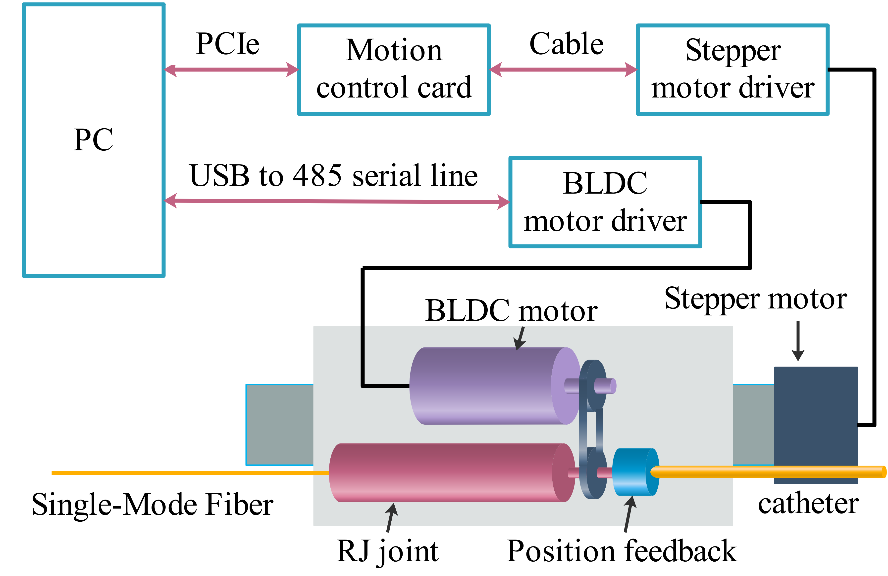
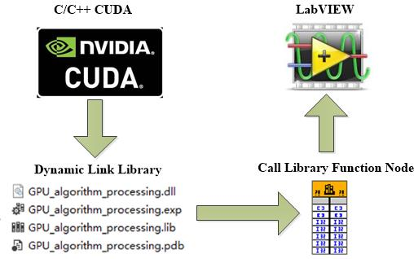
Research and Experiment on Key Technologies of Endoscopic Sweep Frequency OCT System
Jing Lyu
School of Biomedical Engineering (Suzhou), Division of life Sciences and Medicine, University of Science and Technology of China, Suzhou, China
Chinese Academy of Sciences, Suzhou Institute of Biomedical Engineering and Technology, Suzhou, China
Lin Ren
Chinese Academy of Sciences
Suzhou Institute of Biomedical Engineering and Technology
Suzhou, China
Qinying Liu
Chinese Academy of Sciences
Suzhou Institute of Biomedical Engineering and Technology
Suzhou, China
Yan Wang
Chinese Academy of Sciences
Suzhou Institute of Biomedical Engineering and Technology
Suzhou, China
Yuguo Tang
School of Biomedical Engineering (Suzhou), Division of life Sciences and Medicine, University of Science and Technology of China, Suzhou, China
Chinese Academy of Sciences, Suzhou Institute of Biomedical Engineering and Technology, Suzhou, China
Min Li*
Chinese Academy of Sciences
Suzhou Institute of Biomedical Engineering and Technology
Suzhou, China
limin@sibet.ac.cn
Abstract—In this paper, a high-speed swept frequency laser light source is used, combined with FPGA and GPU acceleration technology to design a high-speed endoscopic Swept-source optical coherence tomography (SS-OCT) system. Several key parameters that affect the performance of the system are tested. The results show that the system's imaging depth is 4.5mm, imaging resolution is 7.3μm, and system sensitivity is 110dB in air. The image of finger tissue is stable and the structure is clear. When the rotation speed reaches 9000RPM, the real-time frame rate of the system can reach 141 frames per second.
Conclusion
In this paper, a high-speed endoscopic sweep frequency OCT (SS-OCT) system is designed based on a 200kHz swept frequency light source, and Several key parameters that affect the performance of the system are described. By using the deterministic characteristics of FPGA high-speed clock and GPU multi-threading advantages, we realizes real-time imaging. Test results shows that the imaging depth is 4.5mm, imaging resolution is 7.3μm, and system sensitivity is 110dB in air. the image structure of biological tissue is clear, and the maximum real-time frame rate can reach 141 frames per second.

