Slide 1



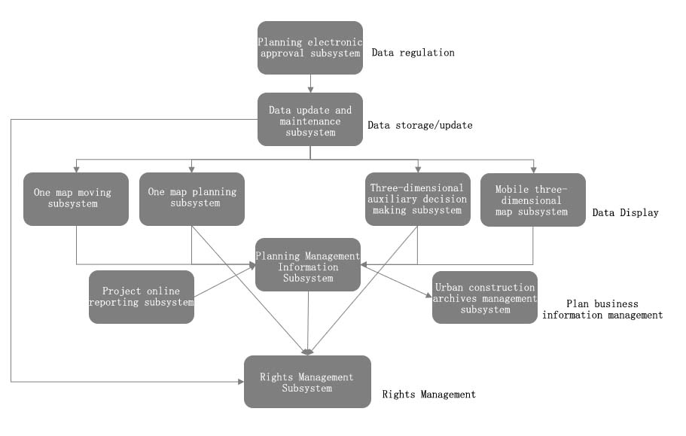
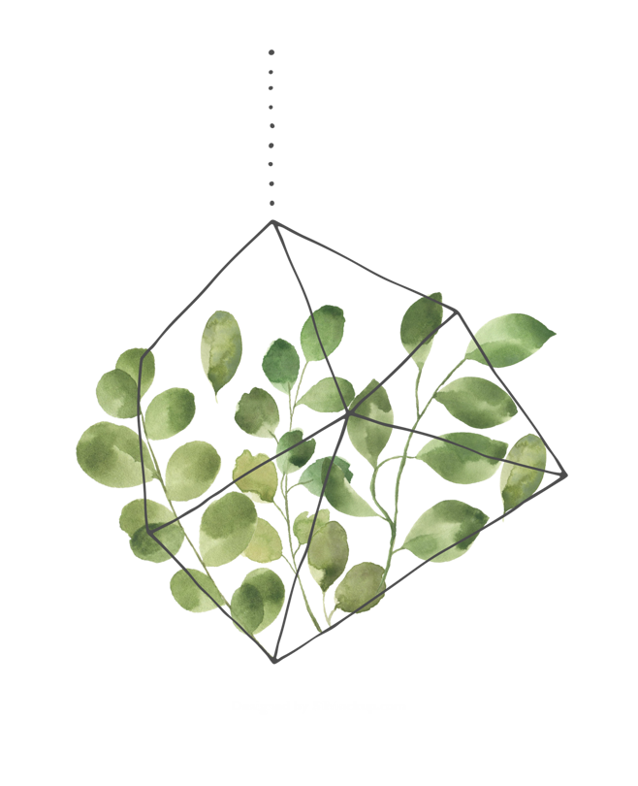
Research on the Design and Key Technology of "Smart Housing Construction" Service Management Platform-Taking Zhijiang City as an Example
Abstract
In view of the low level of informatization of urban planning and engineering management in China, taking Zhijiang City as an example, through the construction of urban "smart housing construction" management service platform, various decentralized systems are organized through a unified portal platform to provide internal and external application services, realize internal e-government, and establish the standardization of overall planning management, To solve the problems of planning management, to promote the standardization of planning business management, to realize the office automation of business management, to improve the efficiency of daily office work of business personnel, to release information, to unify the business declaration standard, and to improve the efficiency of public business declaration, the construction of the platform will greatly enhance the scientific decision-making and efficiency of planning management department.
Construction Content
The urban "smart housing and construction" management service platform includes the project online construction reporting subsystem, planning management information subsystem, urban construction archives management subsystem, three-dimensional auxiliary decision-making subsystem and other systems, covering multiple application subsystems. The specific construction content is as follows TABLE I:
Fig. 1. The relationship between the various systems in the platform
Overall Architecture
In accordance with the overall requirements of the project, the overall design of Zhijiang City’s "Smart Housing and Construction" information management platform project is to build a highly practical and versatile information platform. The "Smart Housing and Construction" system adopts service-oriented (SOA) concepts and technologies, uses a multi-layer structure system, and makes full use of mature technologies such as .NET, Web Service, XML, and transaction processing to ensure the system's high stability, practicability and Scalability [5-6].
Supported by the security assurance system and standard specification system, the framework is mainly composed of four layers:1)Infrastructure service layer 2)Data service layer 3)Platform service layer 4)Application service layer.
Conclusion
At present, the development of urban housing construction in China is in the stage of developing from "digital housing construction" to "smart housing construction". According to the "smart city" and the country's overall requirements for the construction of e-government systems, this article takes the current Zhijiang city The informatization level of urban housing and construction management is the goal, with the goal of "coordination, distributed implementation, and unified platform", gradually enriching data resources, improving and upgrading informatization services, using network technology, information management, GIS, multimedia and other technologies, The overall framework of urban housing construction management informatization of "1 database, 1 operating environment, and 1 platform" was determined. The planning and management work has become more "reasonable and followable", improving the efficiency of daily office work of business personnel; creating a sunny plan.
Time and Space Benchmark
The time-space benchmark is an important infrastructure for economic construction, national defense construction, and social development. It is the basic basis for time and space data in terms of time and space [7]. The date in the time base should be in the Gregorian calendar era, and the time should be in Beijing time. The plane coordinate system adopts the CGCS2000 coordinate system uniformly specified by the National Bureau of Surveying, Mapping and Geographic Information. The average altitude of Zhijiang City is 45 meters. Due to the use of the standard central meridian, the projection length deformation value within the urban area is 7.1 cm/km, which does not meet CJJ/T8-2011 The "Urban Survey Code" stipulates that the projection length deformation value is not greater than 2.5cm/km, so after strict theoretical calculations, the topographic map adopts Gauss-Krüger 3° zone projection, and the central meridian is 111°45′00″, The elevation adopts the 1985 national elevation datum.

