Slide 1


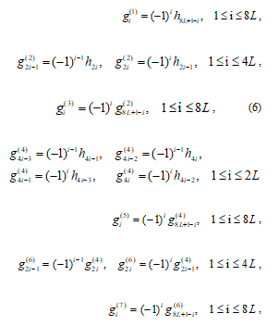








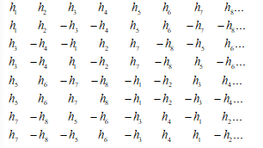

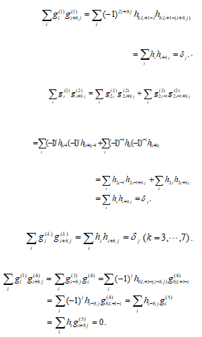
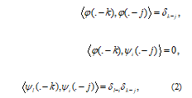
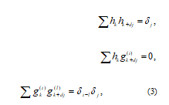


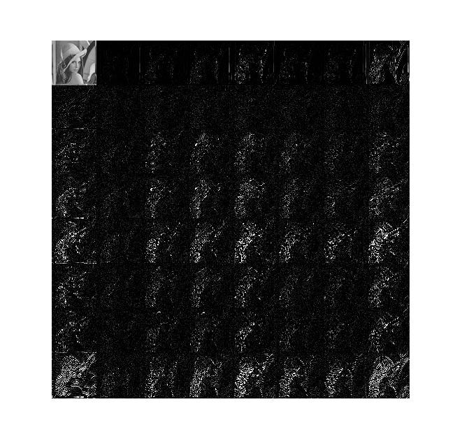


Eight-Band Orthogonal Wavelets for Fast Calculation
Abstract
The symmetry or anti-symmetry 8-bank orthogonal wavelet filters for fast calculation with high order vanishing moment and short support are constructed by using the ingenious structure. The low-pass filter can determine seven high-pass filters by changing the sign and position in this wavelet system. This construction brings a lot of convenience for our calculation, which can be applied to the engineering background for using the free degrees.
Let
Let
Thus,
Preliminaries
In an orthogonal multi-band wavelet system, let be the scaling functions, be the wavelet functions. ,can be expressed as follows:
It follows that
Respectively. Obviously, we can see that are symmetric,are antisymmetric, respectively.
For example, when , the filter banks are
Similarly,
Since
By direct calculation, we can see that
Respectively, with
Respectively, or equivalently,
Clearly, all of wavelet filters are determined by the low-pass filter. So this structure brings a lot of convenience for the calculation.
Theorem 3.1 If
Where denotes the Dirac sequence such that for, otherwise , is low-pass filters and is one of the high-pass filter.
Definition 2.1 If
Conclusion
We study systematically a class of symmetric or anti-symmetric eight-bank orthogonal wavelet filters for fast calculation with compactly supported, in which the low-pass filter can determine seven high-pass filters by changing the sign and position. Thus, this construction brings a lot of convenience for the calculation. Fig. 2. is the decomposed Lena using eight-band wavelets. Clearly, they are different to two-band wavelet. We will study the special eight-band wavelets with high vanishing moments for fast calculation in image compression.
Then the high-pass filter has vanishing moments of order .
Construction of orthogonal multi-band wavelets for fast calculation
Then the wavelet filter banks defined by (5) and (6) satisfy the orthogonality condition.
Proof: Note that , and is symmetric, i.e., .
Firstly, we can prove
Assume the lengths of and are all . Denote the low filter be
Which is symmetric.
Let
Fig. 1. The first one is the scale functions, and the other are wavelet functions.

