Slide 1

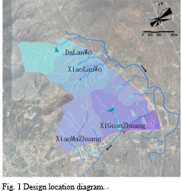
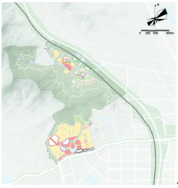
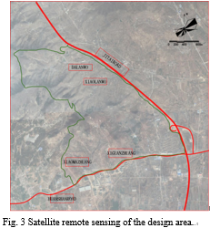
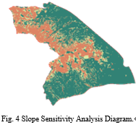
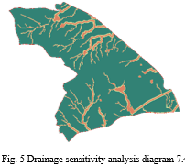
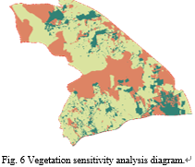
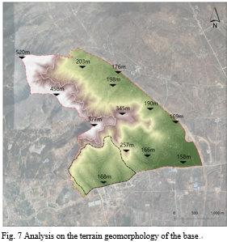
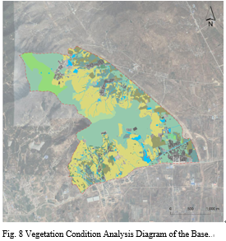
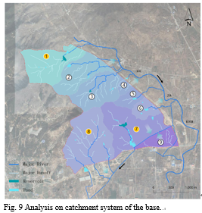
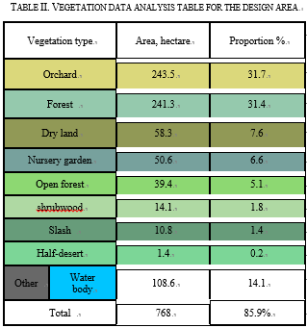
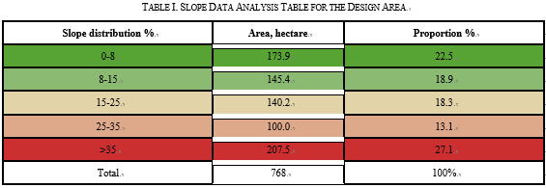
2021 IEEE Conference on Telecommunications, Optics and Computer Science (TOCS 2021)
Shenyang, China
December 10-11, 2021
Study on Mountain Space in Mount Tai Region Based on GIS Spatial Data Analysis
Congcong Liu
School of Information and Arts
Shandong Institute of Commerce and Technology
Shandong, Jinan 250103, China
Fei Wang*
School of Information and Arts
Shandong Institute of Commerce and Technology
Shandong, Jinan 250103, China
1615781880@qq.com
Wengang Wang
Shandong Commercial Architectural Design Co., Ltd.
Shandong, Jinan 250101, China
Qingliang Zhang
Shandong Commercial Architectural Design Co., Ltd.
Shandong, Jinan 250101, China
Lingfang Zhang
Shandong Commercial Architectural Design Co., Ltd.
Shandong, Jinan 250101, China
Abstract—With the continuous development and wide application of computer big data, reasonable application of computer new GIS space data enables us to access more spatial, geographic information, which helps us comprehensively upgrade the overall design of mountain space, increase data support and design scientificity in system design, thereby improving feasibility of various decisions for mountain spatial planning and design. This study selects hogback mountain in Mount Tai region as the research area. Technically supported by RS and GIS, we take SPOT satellite remote sensing images as the main data source, analyze big data such as road mountain, water, sensitivity of hogback mountain in Mount Tai region through GIS remote sensing interpretation, establish big data geographic information database, determine the mountain space planning principles and project positioning, function. In effort to provide data support and technical reference for the subsequent building of landscape, forest, lake, field, grass and life community, big data GIS technology analysis carries great significance.
Introduction
GIS operation is to collect, process, analyze its data in the space design based on computer technology, and provide powerful data support for the dynamic effect of geographic information [1]. GIS data allows setting of map projection, scale based on actual engineering scale. The setting process is free from influence of any publishing size and any purpose, which can be done directly according to the actual requirements in the fastest speed [2].
In 2020, the Shandong Provincial Government proposed to guide natural resources work with green development concepts, and actively develop surveying geographic information industries, requiring coverage of 0.5 m resolution aviation images over the province [3]. According to the government and market demand, GIS space data represents a transformation from the traditional period to big data period under the wave of big data. By using GIS and RS technology, we can access more spatial, geographic information. Different from traditional GIS, in which contour line in the design area is plotted to the map, GIS spatial data is visualized. The data is analyzed and calculated to indicate its spatial layout, polymer level, and coupling association, etc., which helps to comprehensively enhance overall design of the mountain space, increase data support and design scientificity in the system design, thereby improving the feasibility of various decisions for the planning and design of the mountain space [4].
Fig. 2 Administrative area drawing in the project design
Conclusion
According to remote sensing interpretation: low environmental sensitivity regions in the design area account for 62%, which is ready for environmentally friendly development and human activities; high-sensitive areas should be mainly protected without development; in mountain ecological protection, we should try to keep integrity of ridge lines, single hills, slow ridges as far as possible. 25%-35% slope area in the design area can be developed appropriately, area with slope above 25% demands vegetation restoration to conserve water and soil. In the design area, we should avoid construction in the ecological sensitive area (zone not suitable for development); in the area relatively suitable for development, a small amount of lightweight construction is applicable; area suitable for development needs low intensity construction. Area suitable for development accounts for 31.6% of the total area, area relatively suitable for development accounts for 17.1% of the total area, and area unsuitable for development account for 51.3% of the total area.
With the rapid development of urban construction, it is urgent to provide big data support and guidance for urban development using GIS technology with strong spatial data processing and analysis functions. With the improvement of relevant computer technology and in-depth study of GIS knowledge, GIS will be more reasonable, scientific and more effectively used in spatial planning design.

