Slide 1
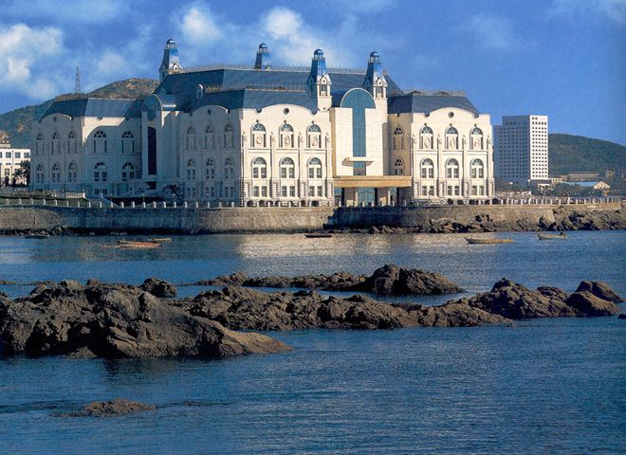
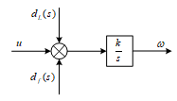
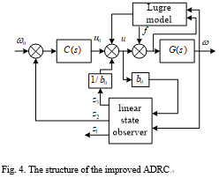
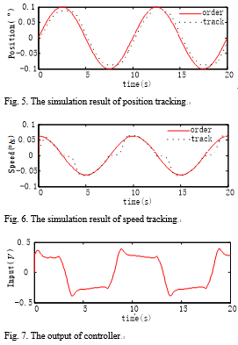
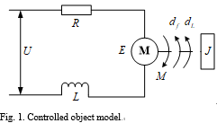
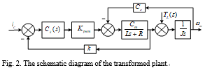
2021 IEEE Conference on Telecommunications, Optics and Computer Science (TOCS 2021)
Shenyang, China
December 10-11, 2021
An Improved Method of Friction Compensation and Stability Control for Optoelectronic Stabilized Platform
Peng Gao*
Xi'an Institute of Optics and Precision Mechanics, Chinese Academy of Sciences, Xi’an, 710119, China
School of Electronic and Information Engineering, Xi'an Jiaotong University, Xi’an, 710049, China
University of Chinese Academy of Sciences, Beijing 100049, China
gaopeng1@opt.ac.cn
Weiguo Lu
Xi'an Institute of Optics and Precision Mechanics
Chinese Academy of Sciences
Xi’an, 710119, China
Wenbo Zhang
Xi'an Institute of Optics and Precision Mechanics, Chinese Academy of Sciences, Xi’an, 710119, China
School of Electronic and Information Engineering, Xi'an Jiaotong University, Xi’an, 710049, China
University of Chinese Academy of Sciences, Beijing 100049, China
Abstract—In order to improve the anti - disturbance ability of the optoelectronic stabilized platform, an improved active disturbance rejection control algorithm is proposed, which combines LuGre friction model and linear reduced extended state observer. Firstly, LuGre friction model is established to compensate the friction torque of bearing. Then, the friction compensation error and other disturbances are regarded as an extended state, which is estimated by a linear reduced-order extended state observer. The estimated value is fed back to the controller to further compensate the disturbance. The improved ADRC algorithm has superior disturbance rejection ability taking advantage of the accurate compensation of LuGre model and the adaptation of extended state observation. Experimental results show that the improved algorithm can well suppress external interferences and significantly improve the ability of anti-interference and tracking response of the system.
Fig. 3. The simplified schematic diagram of the controlled plant
Introduction
The optoelectronic stabilized platform is widely used in aerospace field, whose main function is to restrain disturbances and provide optical axis stabilization environment for optical loads such as visible optical camera, infrared camera and laser [1]. The optical loads can still maintain high-definition and stable imaging in the environment of attitude change and vibration of the carrier.
In working process, the platform is affected by complex disturbance factors, mainly including attitude change, friction between bearings, high-frequency vibration, sensor noise, mass imbalance and so on [2]. The friction torque has the characteristics of mutation and nonlinearity, which produces a significant influence on the stability control in the optoelectronic stabilized platform. The friction torque belongs to nonlinear disturbance, to which the suppression ability of the traditional linear controller is insufficient. Especially in the low-speed situation, the speed control fluctuates obviously due to the interference of friction, which affects the optical axis stability of the photoelectric platform. It is significant to establish friction model to estimate friction torque and input the estimator into the controller, so as to compensate the friction torque. The common friction models include Karnopp model, Stribeck model, LuGre model, etc [3]. LuGre is a classical friction model proposed by Canudas, which can well describe dynamic and static characteristics of friction.
Firstly, the friction torque in the system is compensated by establishing LuGre friction model of the system and distinguishing parameters in LuGre friction model. Then, the friction compensation error and other disturbances are regarded as an extended state, and the extended state observer (ESO) is used to estimate the extended state. Finally, the estimated value of the expansion state is compensated to the input of the controller to compensate the residual interference. An improved active disturbance rejection control algorithm (ADRC) is proposed by combining LuGre model and linear reduced order extended state observer.
Conclusion
The platform is affected by many kinds of disturbances, among which friction interference is one of the most important interferences. In order to effectively suppress the disturbance, the LuGre is established to compensate friction torque independently, then ESO is used to estimate friction compensation error and other disturbances, and the estimation of which is fed back to input of the controller to further compensate disturbances. Finally, an improved ADRC algorithm is established by combining LuGre model and linear reduced-order ESO.
The platform is mainly composed of angle sensor, motor, gyro and platform frame. Its model structure can be shown in Figure 1 [4]. The controlled object mainly involves three dynamic equations, as shown below:

