Slide 1




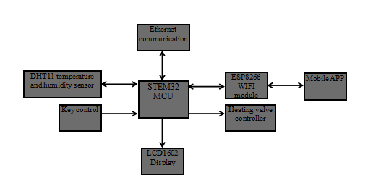


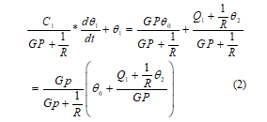

A Design of Intelligent Group Control System for Heating in Elderly Care Community
Abstract
At present, with the development of the elderly care industry, there are many problems in the heating system of the domestic elderly care community, such as great changes in room temperature and poor comfort. The intelligent heating group control system designed in this paper can independently set the heating controller according to the situation of each user in the community, and effectively realize the precise control and adjustment of the temperature of each independent household, which not only achieves the purpose of energy saving, but also can realize the optimal control and management of the heating network. It is a relatively humanized design. In addition, the system can shut down the heating of the houses that are vacant for a long time in time to avoid the waste of resources. Community managers can also remotely observe and control the temperature of each household through the host computer monitoring software to ensure that the heating temperature of each room is suitable for the elderly.
Overall Structure of the System
According to the above design ideas, combined with the characteristics of centralized monitoring and distributed control, we designed the overall structure of the heating system, as shown in Fig. 1
Hardware Design of Distributed Temperature Control for Each User
According to the temperature control of each household in the elderly care community, we designed an automatic temperature control subsystem for each household by using STEM32 MCU. The specific structure diagram is as Fig. 2.
Host computer monitoring
Ethernet
Main controller
Main heating valve of the community
MCU system
MCU system
Heating valve of household
Heating valve of household
……
Fig. 2 Automatic control subsystem of household temperature
Fig. 1 Heating group control system diagram
Modeling of household temperature control system
Generally, to obtain the mathematical model of the process, it is necessary to first determine the structural form of the model through mechanism analysis, and then determine the size of each coefficient in the model through experimental data. There are many uncertain factors in the room, so it is impossible to accurately obtain the mathematical model of air-conditioned room temperature through process identification [9-11]. However, by analyzing the mechanism of each household temperature controlled process in the elderly care community, according to the energy balance and other relations, the mathematical model of the process can be established by applying the mathematical description method.
V.Conclusion
Nowadays, the aging problem in China is getting more and more serious, and people pay more and more attention to the problem of the elderly, which puts forward higher requirements for the living environment. However, the heating intelligence of most elderly care communities is relatively low, which is no longer suitable for the current national conditions of China. Our heating control system can independently set the heating temperature for each household according to the actual needs, and the main control room can also control the heating situation of each household in the community. Of course, this design needs to be further improved and optimized, for example, by installing special sensing devices, to automatically sense the normal operation of the heating facilities, etc. As the construction of heating system is a major livelihood project, there is a process to promote all the work, but the popularization of intelligent heating is a major trend, and the intelligent heating control system will certainly become more and more complete
The mathematical expression of the above relationship is:
Where - Indoor heat capacity coefficient; - Indoor air temperature; G- Hot water supply; p - Specific heat of heating hot water; - Initial temperature of radiator; - Heat dissipation of indoor equipment and lighting; - Outdoor air temperature; R- Thermal resistance of room envelope.
The formula (1) is organized as:

