Slide 1
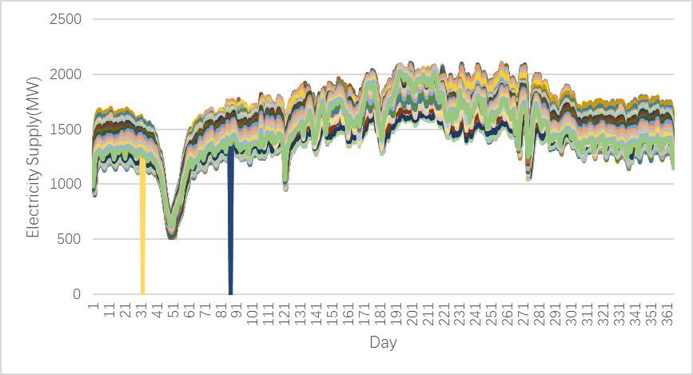
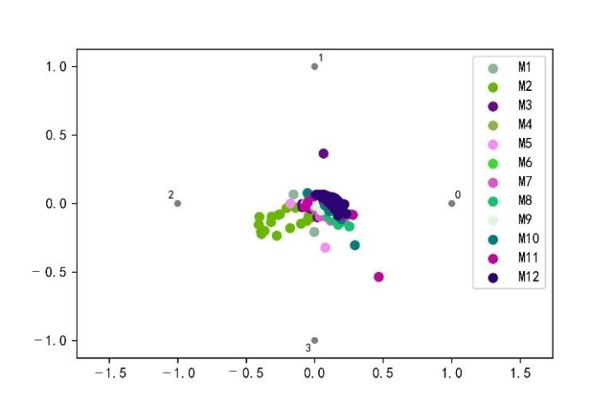
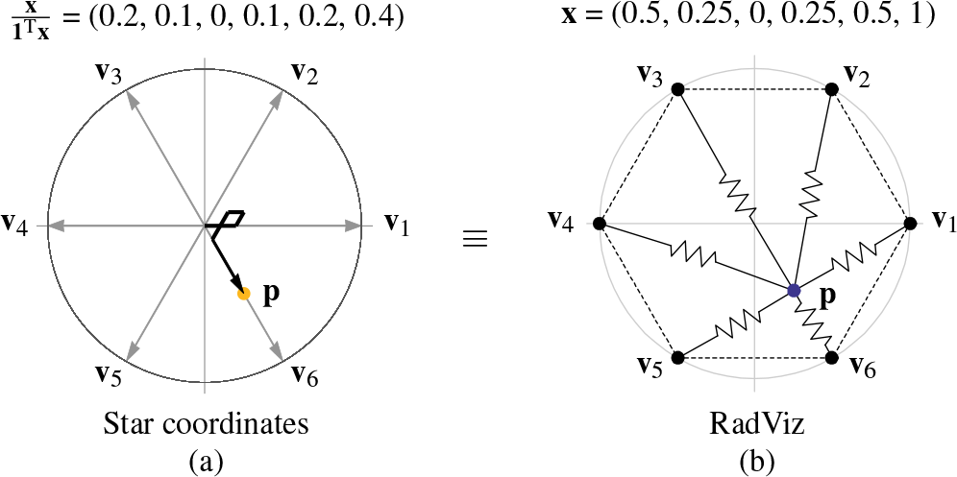
Advanced Manufacturing Data Space Visualization Based on PCA-Radviz Model
Jianjun Wang*
School of Economics and Management
North China Electric Power University
Beijing, China
wangjianjunhd@126.com
Yan Zhou
School of Economics and Management
North China Electric Power University
Beijing, China
binghuoice@163.com
Ran Wang
School of Economics and Management
North China Electric Power University
Beijing, China
2954767243@qq.com
Abstract—Radviz method is a more commonly used method to visualize multi-dimensional data into a two-dimensional plane, but if there are too many dimensions, Radviz will be shortcomings of overlapping of data performance. At present, China's industry has entered the stage of advanced manufacturing. With the development of Internet technology and big data technology, a big data environment has been created along with the manufacturing supply chain, and the advanced manufacturing data are always belonging to a high-dimensional data, it is difficult to present by Radviz, this paper proposes a visualization algorithm for advanced manufacturing based on principal component analysis(PCA) and Radviz visualization method, which can optimize the expression of multi-dimensional time series on a two-dimensional plane after dimensionality reduction using PCA. Finally, the paper uses power supply as a visual example to verify the proposed mode, and the results show that the proposed model can indeed provide decision-makers with more intuitive decision-making information.
Conclusion
This paper proposes a visualization model of advanced manufacturing based on principal component analysis and Radviz visualization, which can express the dimensionality reduction of multi-dimensional time series supply images on a two-dimensional plane. In this paper, the given model is verified by taking electric power supply as an example. The verification shows that the method proposed in this paper can indeed provide more intuitive decision-making information to decision-makers.

