Slide 1

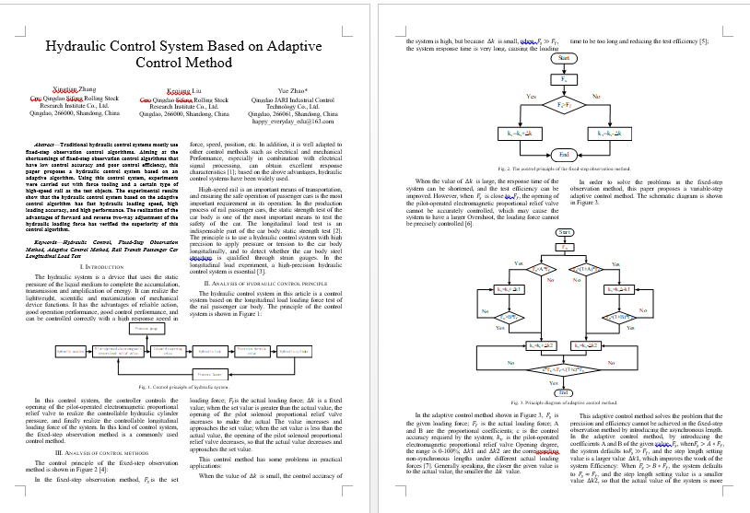
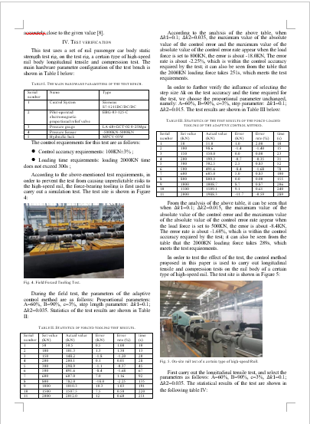
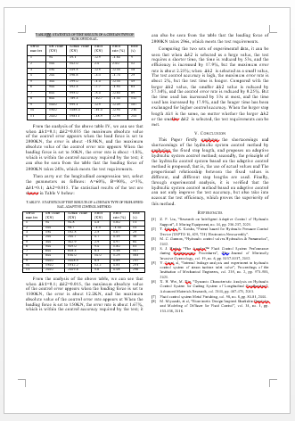
Hydraulic Control System Based on Adaptive Control Method
Xingtian Zhang
Crrc Qingdao Sifang Rolling Stock Research Institute Co., Ltd.
Qingdao, 266000, Shandong, China
Keqiang Liu
Crrc Qingdao Sifang Rolling Stock Research Institute Co., Ltd.
Qingdao, 266000, Shandong, China
Yue Zhao*
Qingdao JARI Industrial Control Technology Co., Ltd.
Qingdao, 266061, Shandong, China
happy_everyday_edu@163.com
Abstract
Traditional hydraulic control systems mostly use fixed-step observation control algorithms. Aiming at the shortcomings of fixed-step observation control algorithms that have low control accuracy and poor control efficiency, this paper proposes a hydraulic control system based on an adaptive algorithm. Using this control system, experiments were carried out with force tooling and a certain type of high-speed rail as the test objects. The experimental results show that the hydraulic control system based on the adaptive control algorithm has fast hydraulic loading speed, high loading accuracy, and high performance. The realization of the advantages of forward and reverse two-way adjustment of the hydraulic loading force has verified the superiority of this control algorithm.

