Slide 1
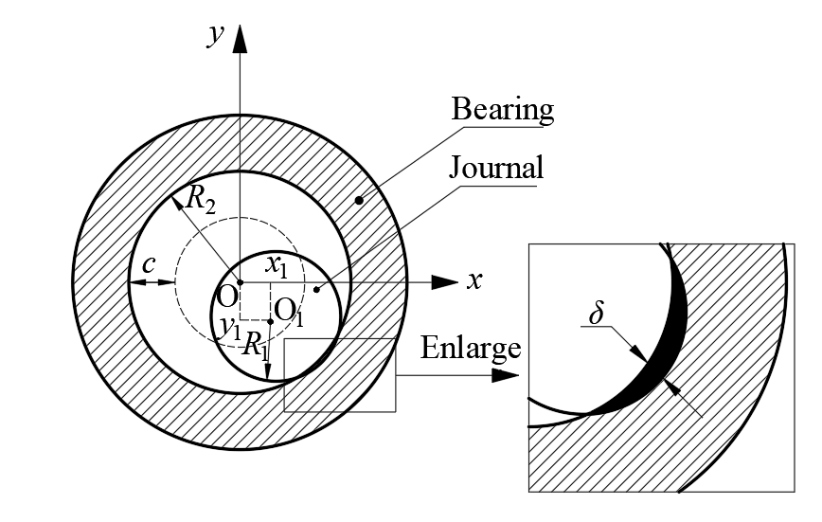
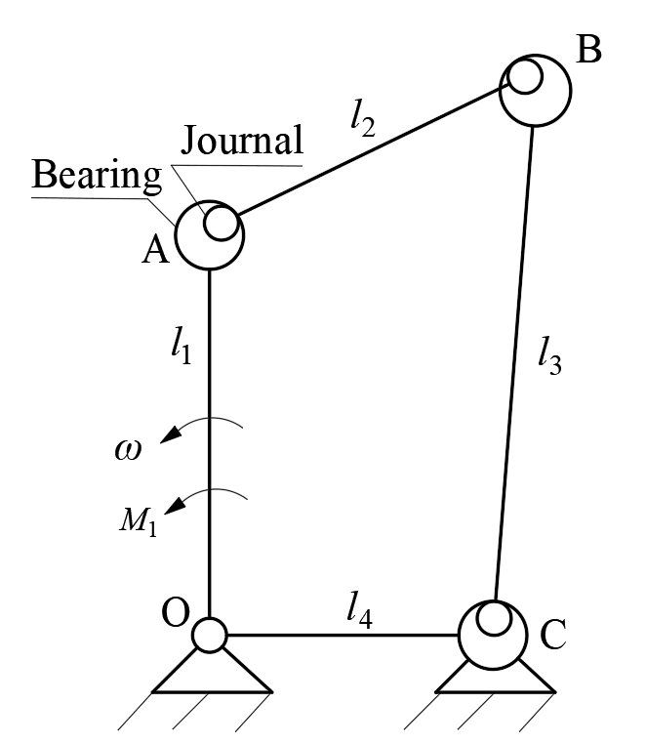
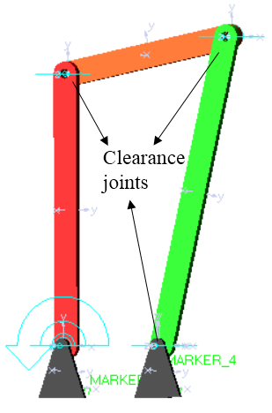
Dynamic simulation and analysis of planar four-link mechanism with multi-clearance
Hou Xurui，Jin Guoguang1,2,*，Wei Zhan1,2，Wang Zhimin
School of Mechanical Engineering, Tiangong University
Abstract: In order to study the influence of multi-clearance on the dynamic performance of mechanism, a dynamic model with clearance of mechanism is established based on the system dynamics theory by combining the two-state clearance model of rotating pair. Based on the dynamic model, taking the planar four-link mechanism as the research object, the influence of position and quantity of clearance on acceleration and penetration depth of clearance joint are studied by using ADAMS simulation software. Taking the mean square deviation of rocker acceleration as the quantitative analysis index, all cases of clearance are analyzed quantitatively. The results show that clearance has a great influence on the acceleration of the mechanism. After the system is stabilized, the number and position of clearances will not change the motion state of the journal, and journal and bearing are always in contact. In the case of single clearance, the clearance joint closest to the motor position has the greatest influence on the dynamic response of the mechanism. There are complex coupling effects between multi-clearance joints, and the number of clearances is not the only factor affecting the dynamic performance of the mechanism. The research results have important theoretical guidance value for rational setting of mechanism clearance.
1. Introduction
2. Clearance state model
3. Conclusions
.In recent years The clearance size of kinematic pair is affected by design error, assembly error and wear. The size, position and quantity of clearance have a great influence on the operation accuracy of mechanism. In order to improve the kinematic accuracy and service life of mechanism, it is of great significance to study the dynamics of mechanism with clearance.
Bai Z F et al.[1] studied the dynamic response of multi-body mechanical system with multiple rotating clearance joints by numerical method. Liu C et al.[2] analyzed the elastic force among cylindrical joints with clearance, and put forward an elastic force model with wider application range and higher accuracy. Taking crank-slider mechanism as the research object, Varedi S et al.[3] optimized the mass distribution of mechanism and relieved the impact of clearance impact force on mechanism based on PSO algorithm. Akhadkar N et al.[4] analyzed the influence of joint clearance on mechanism performance when a joint is driven by state feedback controller. Flores P [5] analyzed wear phenomenon of joint with clearance. Marques F et al.[6] put forward an improved formula for modeling space rotating hinge with radial and axial clearance. Yao X et al.[7] conducted a dynamic modeling analysis on a plane beam with clearance hinges. Wang H et al.[8] dynamically modeled multi-clearance crank-slider mechanism and analyzed chaotic effect of the mechanism. Wan Q et al.[9] studied dynamic characteristics of steering gear drive system with multiple clearance hinges. Sui X et al.[10] established dynamic model of steering gear with clearance and analyzed non-linear dynamic behavior of the system.
This paper takes the planar four-link mechanism as the research object, and establishes the two-state collision model. Then, the collision model is embedded into the system dynamics equations, and the influence of the position and quantity of the clearance on the acceleration of the mechanism and the puncture depth of the clearance joint is analyzed.
(1) In the case of single clearance, the closer the clearance joint is to the motor, the greater the impact on the rocker acceleration. The starting and ending time of rocker acceleration vibration is also different with different clearance positions
(2) The more the number of clearances, the greater the vibration amplitude of rocker acceleration, and the wider the vibration range.
(3) Considering the number and location of clearances, the puncture depth does not necessarily increase with the increase of the number of clearances.
(4) Considering all clearance cases, clearance joint C has the least influence on rocker acceleration, and the combination of clearance joints A and C has the greatest influence on rocker acceleration. There is a complex coupling relationship between multi clearance joints. The number of clearances directly affects the stability of the system, but it is not the more the number of clearances, the worse the dynamic performance of the system.
Fig. 1. Two-state clearance model
4. References
[1] Bai Z F, Sun Y. A study on dynamics of planar multibody mechanical systems with multiple revolute clearance joints[J]. European Journal of Mechanics/A Solids,2016,60: 95-111.
[2] Liu C, Ke Z, Lei Y. The compliance contact model of cylindrical joints with clearances[J]. Acta Mechanica Sinica, 2005, 21(5): 451-458.
[3] Varedi S M, Daniali H M, Dardel M, et al. Optimal dynamic design of a planar slider-crank mechanism with a joint clearance[J]. Mechanism and Machine Theory, 2015, 86: 191-200.
[4] Akhadkar N, Acary V, Brogliato B. Analysis of collocated feedback controllers for four-bar planar mechanisms with joint clearances[J]. Multibody System Dynamics, 2015, 38(2): 1-36.
[5] Flores P. Modeling and simulation of wear in revolute clearance joints in multibody systems[J]. Mechanism and Machine Theory, 2009, 44(6): 1211-1222.
[6] Marques F, Isaac F, Dourado N, et al. An enhanced formulation to model spatial revolute joints with radial and axial clearances[J]. Mechanism and Machine Theory, 2017, 116: 123-144.
[7] Yao X, Guo X, Feng Y B, et al. Dynamic analysis for planar beam with clearance joint[J]. Journal of Sound and Vibration, 2015, 339: 324-341.
[8] Wang H, Zheng X S, Zhou T, et al. Dynamic modeling and characteristic analysis of crank slider mechanism with multi clearance [J]. Journal of natural science of Heilongjiang University, 2021, 38 (02): 218-227.
[9] Wan Q, Liu G, Song C Y, et al. Study on dynamic characteristics of actuator drive system with multiple clearance hinges [J]. Journal of Northwest University of technology, 2020, 38 (05): 994-1000.
[10] Sui X, Han J Y, Liu B, et al. Nonlinear dynamics analysis of rudder surface with clearance [j]. Missile and space transportation technology, 2020 (03): 107-110+116.
Fig. 3: Sketch and three-dimensional model of four-link mechanism with clearance plane

