Slide 1


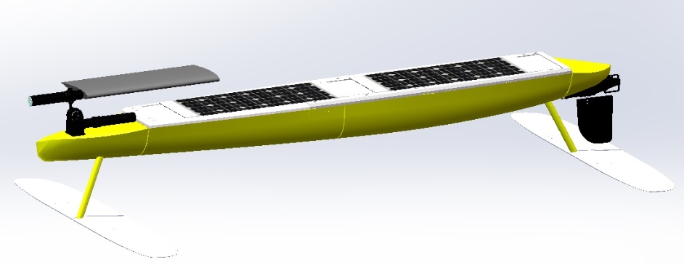
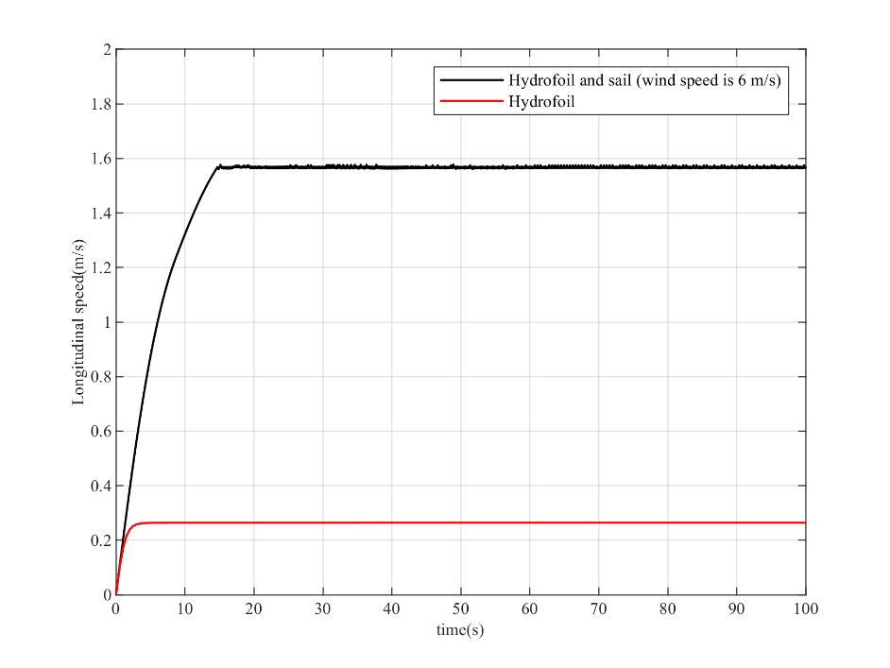
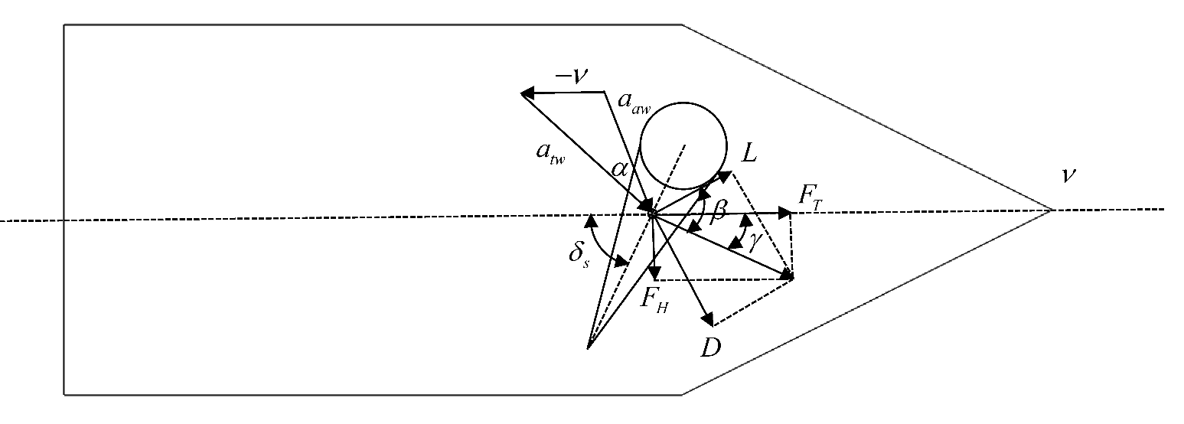
Dynamic simulation and Analysis of Propulsion Performance of Intelligent Unmanned Boat
Shaofeng Guo
School of Mechanical Engineering and Tianjin Key Laboratory of Advanced Mechatronic Equipment Technology
Tiangong University
Tianjin, China
gsfzds@126.com
Abstract—In recent years, the application of renewable energy technologies has increased significantly. A new type of unmanned boat powered by wind and wave was proposed in this paper, and its working principle and detailed design were introduced. A new type of collapsible wing sail was proposed, the force acted on the sail was analyzed, and the influence of wind on the heading propulsion was considered. This paper firstly studied the force of sail, established the MMG three-degree-of-freedom motion mathematical model of a unmanned boat driven by wind and wave, and simulated the motion state of the autonomous unmanned ship through MATLAB software.
Conclusions
The application of unmanned boat driven by renewable energy, such as wind energy and wave energy, is proposed for marine environment observation. And a new type of collapsible wing sail is innovatively put forward. By analyzing the forces acting on the hydrofoil, sail, boat and rudder, a mathematical model of highly nonlinear unmanned boat motion is established. The simulation results show that sail-assisted propulsion has a significant impact on the performance improvement of unmanned boat. This also means that the application of the principle of sail-assisted propulsion to unmanned boat has important practical significance. The developed method can be used to improve the design of unmanned boat driven by winds and waves, the optimal operating conditions of unmanned boat under wind conditions is researched, and wind disturbances under normal motion of unmanned boat is simulated.

