Slide 1

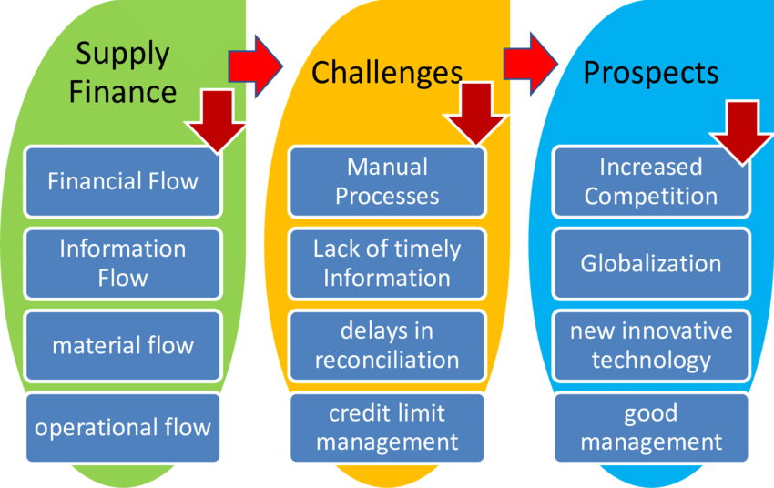
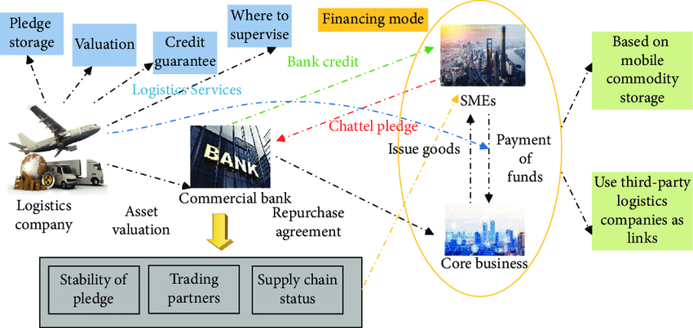
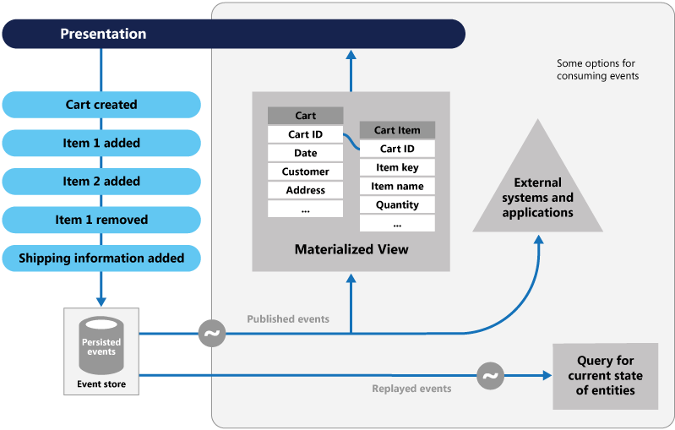
Research and Application of Computer Internet Technology in Intelligent Financial Risk Monitoring System
Abstract
At present, the daily transaction volume of major domestic banks is nearly 10 million, and the average daily transaction volume exceeds 100 billion yuan. A large amount of structured and unstructured transaction data is generated, which is difficult to manage effectively. How to formulate fast and effective financial risk control strategies, improve the efficiency of customer information data processing, and timely predict and prevent credit and fraud risks in the business has become an urgent problem for financial enterprises. The D-Ocean-based financial risk monitoring system relies on the D-Ocean system to efficiently manage massive amounts of data, while using content-based text similarity retrieval, image similarity retrieval based on color and image features, and key frame-based video similarity Retrieval and other technologies fully excavate the practical application of unstructured data in financial risk control.
The division of online supply chain finance
Online supply chain finance refers to the new trend and advanced stage of supply chain finance through informatization collaboration between the financial industry and the physical industry based on supply chain management, including e-commerce transactions, online payments, transaction financing and logistics management, etc. Multiple links are complex financial innovation products [2]. It is an extremely broad concept, combined with industry practices, this article divides online supply chain finance, as shown in Figure 1. First, according to whether the business is integrated with B2B e-commerce, "online supply chain finance" can be divided into "online supply chain finance based on B2B platform" and "electronic/online of traditional offline supply chain finance"; According to whether the B2B platform is self-operated, “online supply chain finance based on B2B platform” can be further divided into “online supply chain finance based on self-operated B2B platform” (such as CCB’s Shanrong Business e-commerce financial service platform) and "Online supply chain finance based on a third-party B2B platform" (e.g., e-Singtong, e-daily, etc., jointly launched by China Construction Bank and a third-party B2B platform).
B.The model evolution of online supply chain finance
Participants of online supply chain finance based on third-party B2B generally include: banks, third-party e-commerce companies, B2B small and medium-sized enterprises, logistics companies and core companies. Third-party e-commerce companies provide banks with new means of risk management and control based on the transaction information and supply chain information of SMEs they have, as well as their ability to predict market risks in trading products. Online supply chain finance takes the e-commerce credit of small and medium-sized enterprises as a supplement to its financial credit, thereby reducing the bank's investigation of the main credit of small and medium-sized enterprises, and controlling loan risks through information management and network information disclosure, and alleviating B2B electronics Figure 2 shows the operating mechanism of the difficulty of financing for business platform member companies [3].
Fig. 1.Schematic diagram of online supply chain finance division
B.Transaction-driven event tracking subsystem
The transaction-driven event tracking subsystem tracks risk events based on risk monitoring records. Log in to the system and first enter the risk display interface, which lists all risk records according to the risk level from high to low. At the same time, the system administrator can also query the records that meet the conditions according to the customer account, account number, and time of record. According to the risk record, we can further track the basic customer information, basic account information, the time of the event, the rule information triggered by the event, the text information generated by the event, the picture information generated by the event, and the video information generated by the time. The system can also manage customers, manage accounts, manage blacklists, manage rules, and query multimedia information. The basic flow chart of the system is shown in Figure 5:
Fig. 2.Schematic diagram of the operation mechanism of online supply chain finance
Conclusion
This article introduces the financial risk control platform based on the rule engine, and proposes a scheme for the aggregation of characteristic factors of the risk control process control, the management of the characteristic library, and the division of risk control modules, which provides an integrated solution for the financial risk control system. It has certain guiding significance for the construction of a modern financial risk control platform.
Fig. 5.The flow chart of the transaction's event tracking subsystem

