Slide 1


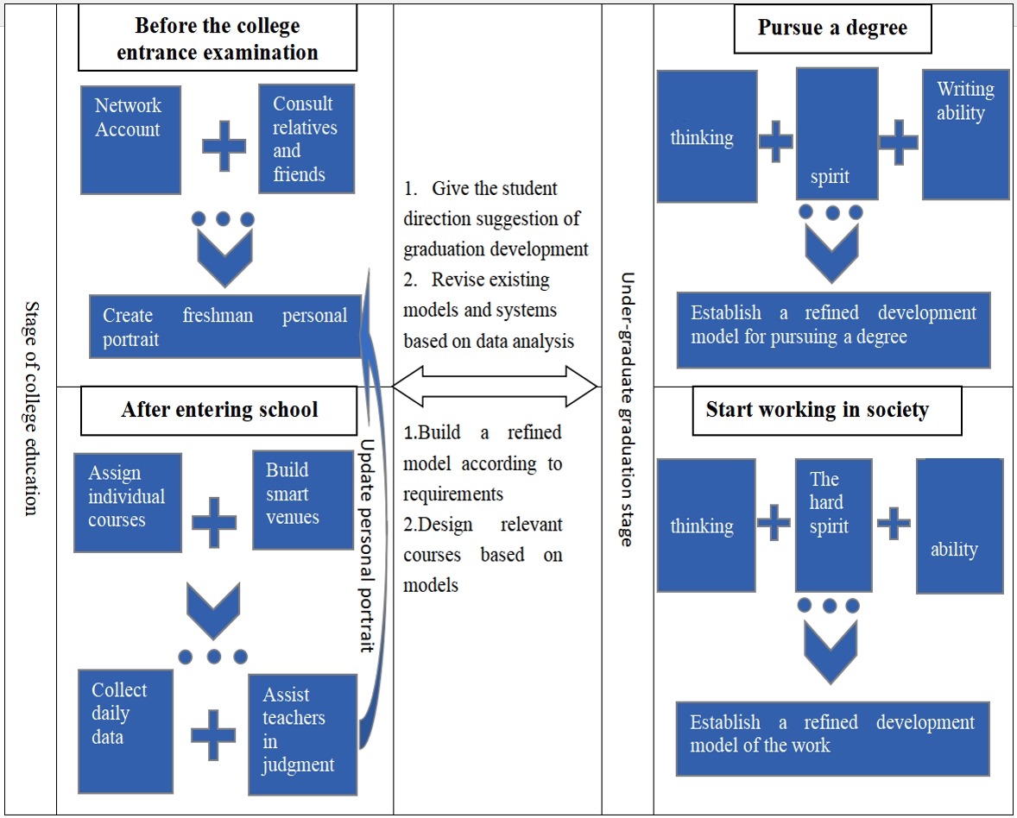
December 10-11, 2021
Shenyang，China
A computer assisted training system based on artificial intelligence and virtual reality technology
Wang Zhan
Dalian Naval Academy
Dalian 116018, China
wangzhan0540@163.com
Dong Guangzhi
Dalian Naval Academy
Dalian 116018, China
2016444838@qq.com
Ba Xinglai
Dalian Naval Academy
Dalian 116018, China
a2215226079@163.com
Abstract—Artificial intelligence technology is being applied to all fields of society at an unprecedented speed with the development of various high and new technologies.Colleges and universities must always be well prepared to meet the educational revolution brought by artificial intelligence with various advanced technologies to achieve high-quality personnel training and social services.A collages and universities personnel training system based on artificial intelligence technology is proposed in this paper after the in-depth study of the history of artificial intelligence and its application problems that may occur in higher education activities with artificial intelligence system in the future.
Conclusion
Education is not a simple transfer of knowledge. Even the most powerful AI can not stimulate the teacher’s thinking completely. We must recognize the limitations of current technology, which proves that the addition of artificial intelligence can only help improve teachers' teaching ability, rather than completely replace the teacher.
We need to admit that the application of the artificial intelligence designed by higher education talent should be a complex system engineering, which needs some time to design, reform, feedback and improvement. At present, we are in the stage of design and reform.We should continue to improve teachers' thinking and ability to use artificial intelligence technology. It promotes the expansion of database and the automation of system gradually, and finally realize the deep integration of artificial intelligence and talent training in higher education.It is hoped that the research of this paper can give the relevant researchers some inspiration. It is believed that with the sustained integration of artificial intelligence, more perfect and optimized models will be put forward continuously.

