Slide 1

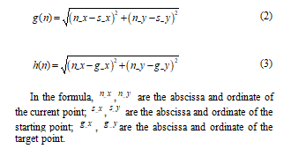
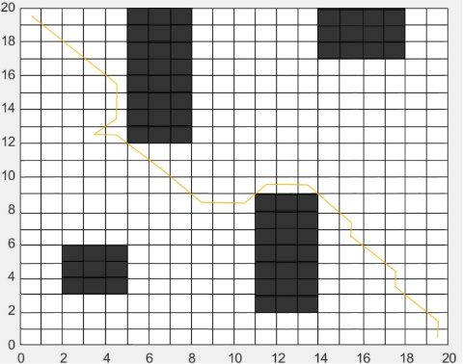
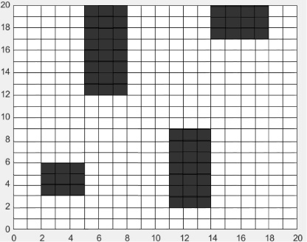
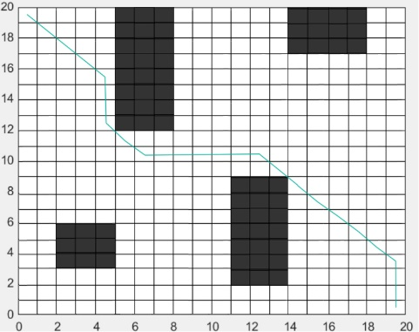


Application of Smart Service Robot Path Planning Based on Improved A* Algorithm
Abstract
Aiming at the problems of long time-consuming path planning and low node search efficiency when the exhibition hall service robots autonomously pick up and deliver items, a global path planning improved A* algorithm is proposed, which adds location information of the service robot on the basis of the traditional evaluation function. Contains the weight function of the cost function and heuristic function; in view of the low efficiency of A* algorithm node search, it is proposed to determine the quadrant where the target is located, and at the same time only perform the depth-first expansion search to the quadrant where the target is located, thereby ignoring other unnecessary quadrants; This paper uses Bezier curve to smooth the planned path, so that the smoothed path is closer to the actual motion path. The experimental results show that the average path length obtained by the improved A* algorithm path planning scheme is 5.34% less than the traditional A* algorithm, and the average time required is reduced by 22.56%. While ensuring the optimal path, it can improve the efficiency of service robot path planning and make the driving trajectory Smoother.
TABLE I. Experimental results of traditional A* algorithm
 | Path Length/m | Distance to the nearest obstacle/m | Running Time/s
1 | 14.03 | 0.41 | 162.33
2 | 12.59 | 0.47 | 172.06
3 | 13.62 | 0.49 | 176.24
4 | 13.16 | 0.37 | 160.26
5 | 12.15 | 0.36 | 158.11
Experimental verification
This article is based on the A* algorithm to improve the evaluation function, which can obtain the optimal path planning results in different exhibition hall environments. In order to verify the effectiveness of the improved algorithm, the traditional A* algorithm and the improved A* algorithm were used for simulation experiments. The exhibition hall environment map is divided into simple and complex types. Point A in the upper left corner is the starting point of the exhibition hall, passing tables and chairs, etc. For obstacles, point B in the lower right corner is the end point of the path, and the path planning is performed 5 times, and the average value is taken. Part of the path planning is shown in Figure 2.
In the same way, the improved A* algorithm is used in the same complex exhibition hall map to conduct five path planning experiments in sequence, and the same variables are controlled as the traditional A* algorithm experiment, thus ensuring the validity and accuracy of the comparison experimental data, and the specific statistics of the experimental results as shown in table II.
TABLE II. Experimental results of the improved A* algorithm
Environmental modeling
Environmental modeling [9] is a map model for robots to acquire environmental features while planning their path. Typical environmental modeling methods include grid method, tangent map method, etc. Among them, the grid method has the advantages of clear structure, convenient creation, and strong ability to express irregular obstacles [10]. Therefore, this paper uses the grid method to analyze the environment. Perform modeling.
The global path planning of the service robot uses the grid method to construct the environment map in the known structured environment indoors. The grid map uses several grids with numerical information to divide the area to be tested to indicate that a certain grid is obstructed. The situation of object occupation, and then obtain the environmental information of the entire grid area [11]. Figure 1 shows the grid map of the exhibition hall environment. The black grid area is an infeasible grid with obstacles such as exhibition stands, tables and chairs, and the blank grid area is a feasible grid.
 | Path Length/m | Distance to the nearest obstacle/m | Running Time/s
1 | 12.56 | 0.27 | 129.37
2 | 12.89 | 0.31 | 131.42
3 | 12.33 | 0.32 | 127.39
4 | 11.92 | 0.26 | 125.01
5 | 12.35 | 0.24 | 128.76
Conclusion
This article aims to improve the traditional A* algorithm in terms of operating efficiency and path length. Through experiments and comparisons with traditional algorithms, the time required for global path planning using this method is reduced by 22.56%, and the path length is reduced by 5.34%, which verifies the effectiveness of the service robot path planning application system based on the improved A* algorithm. The robot can effectively assist the staff in picking and delivering items autonomously.
The specific conclusions of this article are as follows:
(1) A new evaluation function is designed to reduce the waste of time caused by the turning process of the service robot by introducing a time factor;
(2) Introduce the estimated cost weight parameter, and optimize the node search problem by increasing the estimated cost weight from the current node to the target point;
(3) By setting the safety threshold, the useless nodes in the turning nodes are deleted, the key nodes are retained, and the path is optimized.
It is verified by experiments that the improved A* algorithm can enable the service robot to improve the efficiency of node search and make the driving trajectory smoother while ensuring the optimal path, which verifies the effectiveness of the improved A* algorithm.
(A) A* algorithm planning path
(B) Improved A* algorithm planning path
Fig. 1.Raster map
Fig. 2.Experimental results of path planning of two algorithms in a simple map.
III.Global path planning based on improved A* algorithm
For static environment path planning, the traditional A* algorithm can easily and quickly plan a shorter path [12], and its traditional evaluation function is:
The traditional A* algorithm is used to conduct five path planning experiments on the same complex exhibition hall map, where the starting point and ending position of each experiment are the same, in order to control the variable of the starting point and ending point, and then lay the foundation for data analysis. The experimental results statistics are shown in Table I.

