Slide 1
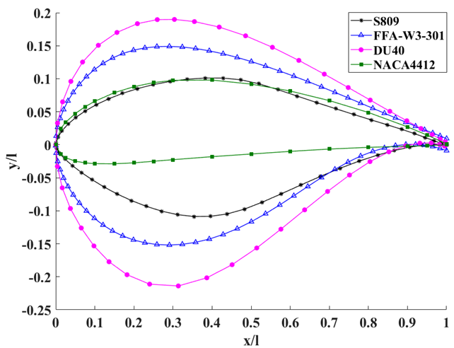
Research on Topology Transformation Method of Wind Turbine Airfoil
Zhaohuang Zhang, Di Gao*, Xiaona Jia, Yutong Li, Bushra Tabassum
School of Energy Power and Mechanical Engineering
North China Electric Power University
Beijing 102206, China
*Corresponding author: 2466594527@qq.com
Abstract—To expand the airfoil database, this paper proposes a new wind turbine airfoil based on topology theory. Firstly, the precise meaning of wind turbine airfoil characteristics and airfoil topology invariants are clarified. Secondly, the nonlinear mapping function of the high-order rotating surface is applied. Based on above, the non-linear mapping of the unchanged airfoil topology structure is realized. Finally, the topological transformation of the airfoil based on the commonly used airfoil S809 for wind turbines is performed, and new airfoils of different shapes are obtained by using different transformation parameters. The XFOIL software is used to study the aerodynamic characteristics of the original airfoil and the newly generated airfoil. The result shows that the airfoil obtained after the transformation may have a good performance or a poor performance simultaneously. The airfoil obtained having a good performance can be added to the airfoil database, whereas the one with poor performance can be optimized later to provide a basic airfoil for the optimal design of airfoil. This article provides a new method for wind turbine airfoil transformation, which broadens the ideas for blade airfoil design and optimization.
Conclusion
This paper proposes a new method for wind turbine airfoil transformation based on topology theory. Ac-cording to the topological characteristics of the airfoil, the meaning of topological equivalence before and after the airfoil transformation is explained and the topo-logical invariants of the airfoil are defined. Based on this, the digital expression of airfoil topology transformation is carried out through a nonlinear mapping function. The S809 airfoil is used as the base airfoil to perform a non-linear mapping with invariable topology structure. Di-fferent transformation parameters are used to obtain new airfoils of different shapes, and XFOIL software is used to analyze the aerodynamic performance of the original airfoils and the newly generated airfoils. The new airfoil obtained from the topological transformation of the original airfoil may be a good performance airfoil or a poor performance airfoil. For the airfoil with poor performance, the airfoil performance optimization can be carried out. For the airfoil with good performance, it can be added to the airfoil database to increase the sample data for the neural network optimization airfoil. Hence, the overall research provides a new methodology for air-foil design and optimization.

