Slide 1

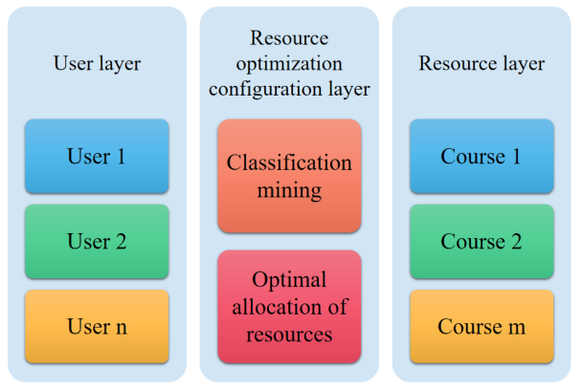
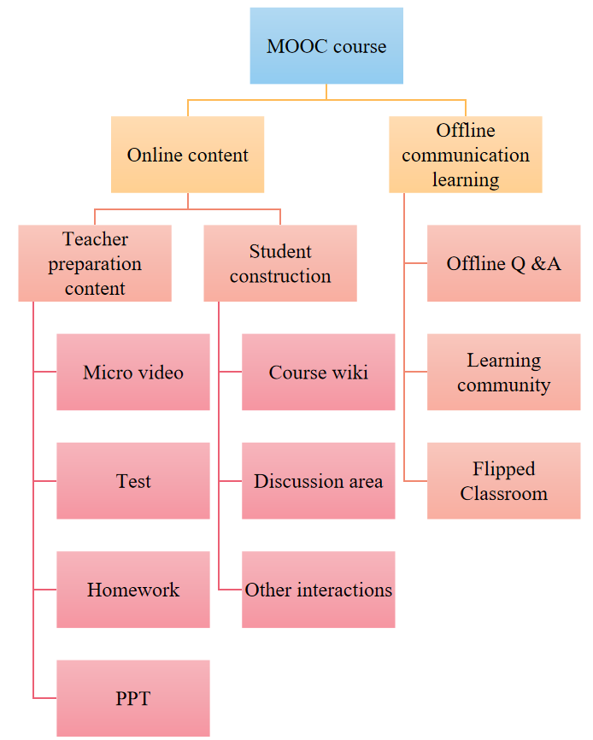
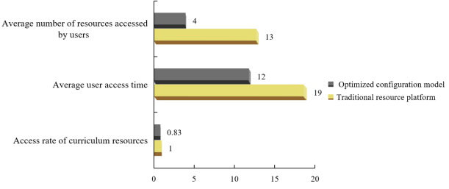
Design and Implementation of Chinese Teaching Resources Optimal Allocation Platform Based on Big Data Technology
Dan Fan
Lanzhou Jiaotong University, Lanzhou, Gansu 730070, China
Fdd1078352791@163.Com
Abstract—Modern Chinese is a professional basic course for Chinese language and literature majors in colleges and universities in China, which plays an important role in the whole major. Chinese language and literature majors talk about professional innovation, professional teaching reform and curriculum integration, which can't be separated from modern Chinese. With its many advantages, big data technology has gradually penetrated and changed all aspects of society, and has expanded from the field of science and technology to the field of education, thus having a certain impact on the university education management system. The classification mining algorithm is used to mine and analyze the data, and the rules and patterns of users' access to curriculum resources are obtained. Collaborative filtering technology and data mining technology are used to match learners' characteristics with online learning resources. Experiments show that compared with the traditional management platform, the optimized management platform can significantly improve the efficiency of users accessing curriculum resources and the utilization rate of curriculum resources.
Conclusion
With the development of the times, Chinese teaching resources are also on the rise, especially the application of new media and network technology has provided abundant teaching resources for current Chinese teaching. Under the new situation, it has become an inevitable trend for universities to use big data technology to optimize the allocation of Chinese teaching resources. We must correctly understand the positive role of big data technology, establish the application concept of big data education management, and speed up the establishment of a platform for optimizing the allocation of Chinese teaching resources. The future smart cloud education platform is bound to develop in an increasingly diversified and innovative direction. As vocational education practitioners, they should constantly consolidate their business foundation, dare to break through the bottleneck of traditional education, and develop intelligent tutorials with a more forward-looking perspective, so as to cultivate more high-quality comprehensive talents with practical application ability for the country.

