Slide 1



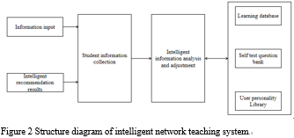
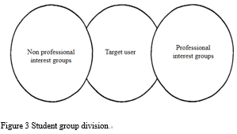
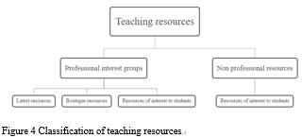
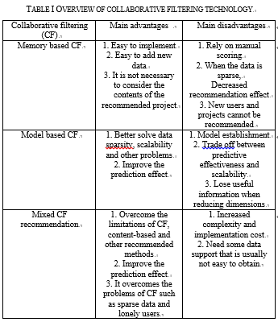

2021 IEEE Conference on Telecommunications, Optics and Computer Science (TOCS 2021)
Shenyang, China
December 10-11, 2021
Research on Content and Mode Recommendation of Humanistic Quality Education for Science and Engineering Students Based on Collaborative Filtering Algorithm
Min Lu
Hainan Open University, Hainan, Haikou 570208, China
lumin2021@126.com
Abstract—The implementation of quality education needs the guarantee of education quality. Training high-quality talents needs to take curriculum as the basic way. Curriculum is the design and planning of education. The training objectives of the school must be achieved through specific courses. The educational policy can be implemented only through specific courses. Teaching activities can be realized only by relying on the curriculum plan. The teaching content can be transformed into students' quality and ability through courses. It can be seen that curriculum is the basic way to implement quality education. As a new educational concept, quality education can be implemented in the whole educational process only when it is internalized into the curriculum and the thoughts of educators. However, with the rapid development of modern science and technology and the establishment of the idea of quality education, the setting of the original curriculum system in China's universities of science and technology has exposed many disadvantages that do not adapt to the development of modern society. Based on this, on the basis of deepening the theoretical research on curriculum, this paper deeply discusses the achievements and existing problems of humanistic quality curriculum in China's universities of science and technology, and then puts forward a set of countermeasures and suggestions for humanistic quality curriculum in Universities of science and technology suitable for China's national conditions.
Figure 1 Main steps of user based collaborative filtering algorithm
Introduction
At present, Internet technology and modern distance education technology are in a period of rapid integration. Learner centered e-learning has rapidly become one of the important forms in the modern education and teaching system because of its advantages such as no time and space constraints, low cost and perfect service function. However, learners are faced with a situation of no choice in the massive learning resources, which is what people call "information overload". The problem of "information overload" has been perplexing learners. How to solve it is urgent. Learning from the successful application of personalized recommendation system in music, video, news media and e-commerce, and research scholars in the field of education also began to turn their attention from traditional teaching to hybrid teaching in the Internet environment [1]. In view of these shortcomings, this paper applies the recommendation algorithm in the recommendation system to the online teaching platform by using the personalized recommendation algorithm based on collaborative filtering. In order to solve the problem of massive educational resources and explore the application of personalized recommendation technology in the field of education, this paper adds a personalized recommendation system to the online teaching platform according to the personalized needs of learners, Provide learners with more efficient and personalized network teaching services.
Conclusion
The idea of humanistic quality education has been put forward for more than ten years, and the University humanistic quality education has also achieved certain results. However, with the rapid growth of China's economy and the continuous expansion of higher education, the ideological and moral level of some college students has decreased and the humanistic spirit is lack, which makes the humanistic quality of students show signs of large-scale decline. These problems directly affect the growth and success of students and the quality of education and teaching in Colleges and universities. Facing this grim reality, university managers must take effective ways and strategies to strengthen the humanistic quality education of college students, improve the current situation, and promote students to establish a correct world outlook, outlook on life and values.

